Slide 1

Introduction to Git and GitHub
MARCH 2024
EPAM Proprietary & Confidential.

Slide 2
Contents
01
Git
02
Git Installation
03
GitHub
04
Git vs GitHub
05
GitHub Setup
06
Git – Setting your credentials
07
Git – Clone/Download a Repository
08
Git – Main Commands
09
Fix Git/GitHub Integration
10
Homework

Slide 3

Git (Version Control System - VCS)
Imagine you and your friends are working together on a big group project, like creating a video game or writing a story.
Now, let's say you're all working on different parts of the project at the same time.
How do you keep track of everyone's changes and make sure you're all working on the same version?
That's where Git comes in!

Slide 4
Git (Version Control System - VCS)
Git is like a magical tool that helps you and your friends work together on projects without stepping on each other's toes

Slide 5
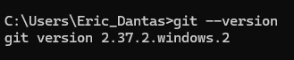
Git (Installation)
Access https://git-scm.com/downloads and download accordingly to your Operational System (Windows, Linux, Mac)
Run the file downloaded
Click on the NEXT buttons till find the INSTALL button
Click on the INSTALL button and wait
After the installation is finished, check if is installed:
Open a Command line (terminal) application
Type: git –version and then hit the enter button

Slide 6

GitHub (Hosting Platform)
Imagine you've written a fantastic story with your friends using Git, but now you want to share it with the world or maybe even get feedback from other people.
That's where GitHub comes in!
GitHub is like a giant library where you can store your projects and collaborate with people from all over the world.

Slide 7

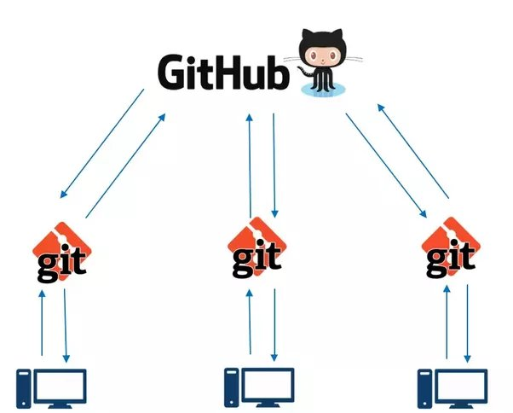
Git is the tool that helps you manage changes in your project locally on your computer.
GitHub is the online platform where you can store your Git projects, collaborate with others, and showcase your work to the world.

Slide 8
GitHub (Setup – Create an Account)
Note: Before work with GitHub, make sure Git is already installed
Access the link https://github.com/ and create an account by clicking on the Sign Up button (top right on the screen)
Type your email and click on the Continue button
Create a password and click on the Continue button
Type a username and click on the Continue button
Click on the Continue button to complete
Verify your account by clicking on the Verify button. After that, you need to solve the puzzle. The puzzle can vary in methods to solve
GitHub will send an 8 numbers code to your email. Copy it and type inside the squares shown by GitHub. If the code is correct, you will be redirected to your GitHub space. Everything is done!

Slide 9
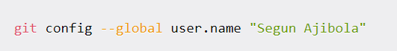
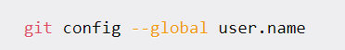
Git (Setting your credentials)
From a terminal (command line), set your username:
Confirm that your username is set:
Set your email:
You will be asked to authenticate your GitHub account, so just sign in with the same email to confirm

Slide 10
Git (Clone/Download a Repository)
Open a terminal from a folder where you want to have your project
Right-click mouse
Click on Open in Terminal
Type the next commands
`git clone` is like making a copy of a project from GitHub onto your computer
git clone https://github.com/ericrommel/ekids.git (in general)
git clone git@github.com:ericrommel/ekids.git (only if you have defined a public SSH key and also only in your own machine)
Go to the folder where you cloned the project and have fun!

Slide 11
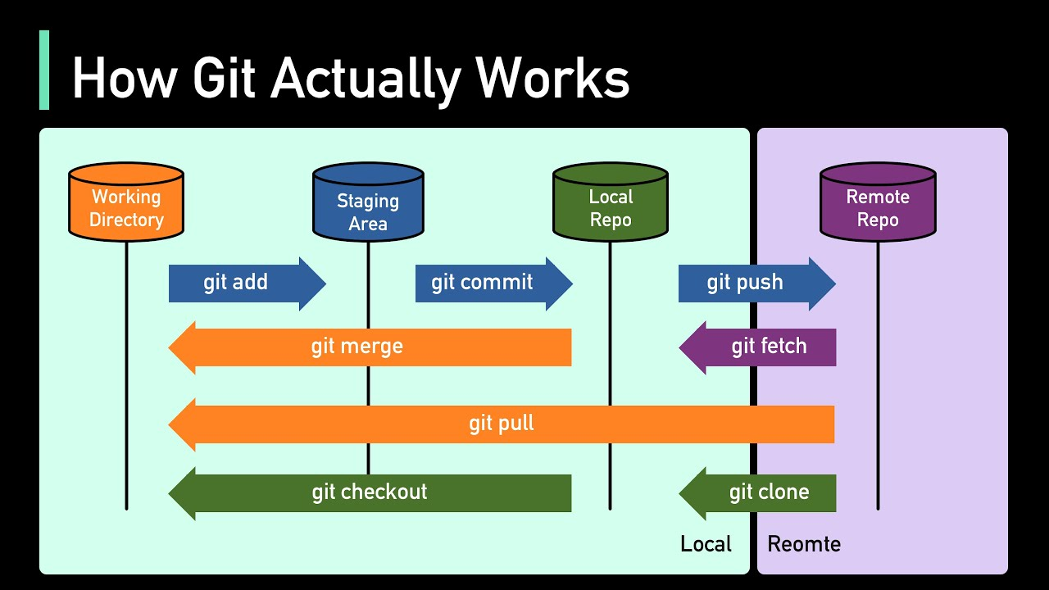
Git (Main commands)

Slide 12
Git (Main commands)
Change to the main branch
git checkout main
Pull the up-to-date files from Github
git pull
Change to your branch
git checkout my-branch-name-here
Merge the changes from remote to your local
git merge main
See what files were changed
git status
Add files that you want to save on Git
git add file-name or git add .
Commit your changes
git commit –m "A nice message to understand what was done"
Push your changes
git push

Slide 13
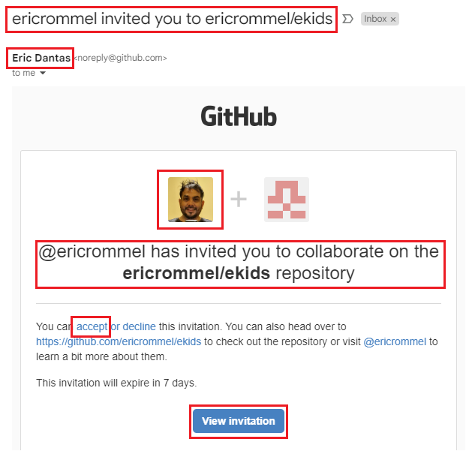
Fix Git/GitHub Integration
To allow you to push changes to the ekids’ repository, you need to accept a collaboration invitation sent to your email connected to your GitHub account
Before clicking on anything, please confirm that the invitation is a valid one (check the highlighted squares)
Click on “accept” or “View invitation”
You need to be logged in to your GitHub account to accept it

Slide 14
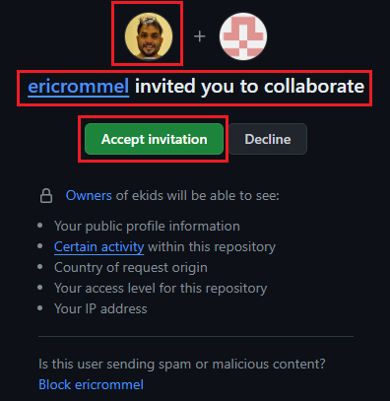
Fix Git/GitHub Integration
GitHub will ask you to accept the invitation. Just click on the green button labeled “Accept invitation”

Slide 15
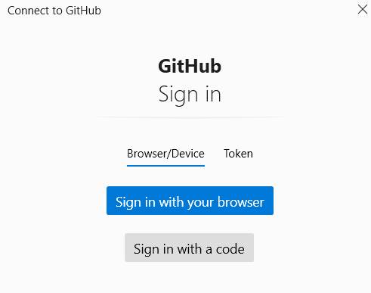
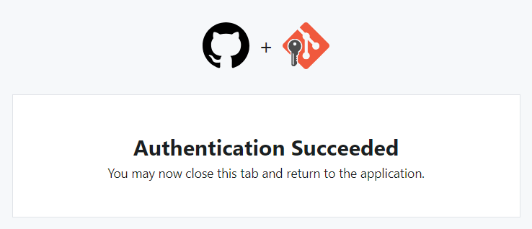
Fix Git/GitHub Integration
At EPAM, as you are using different laptops each time, clone the repository using https://github.com/ericrommel/ekids.git
During the push, you might be prompted to log in using the browser access

Slide 16
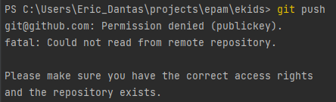
Fix Git/GitHub Integration
If the below message is appearing for you:
You need to follow the next slide steps (use Git Bash terminal)
See that the issue is with the public key.
Probably you don’t have it saved in your machine or in your GitHub account
NOTE: For safety reasons, only do it from your OWN device

Slide 17
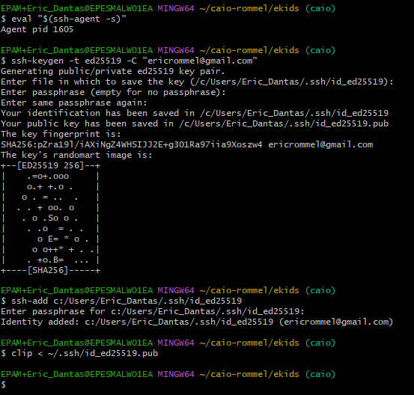
Fix Git/GitHub Integration
1
Turn on ssh-agent
Generate a new SSH key on your local machine (replace to use your email)
Just press Enter
Type a passphrase (don’t forget it)
Re-type the passphrase
Add your SSH key to the ssh-agent
Type your passphrase defined
Copy the SSH public key to your clipboard (memory)
2
4
3
5
6
7
8

Slide 18
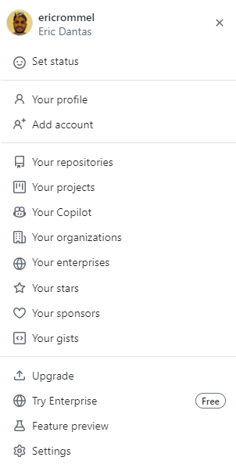
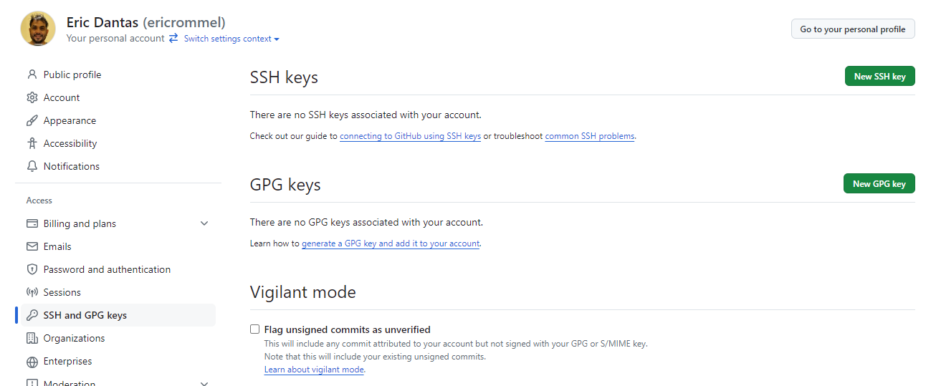
Fix Git/GitHub Integration
Now, go to your GitHub account and save your SSH KEY copied before
3
2
1

Slide 19
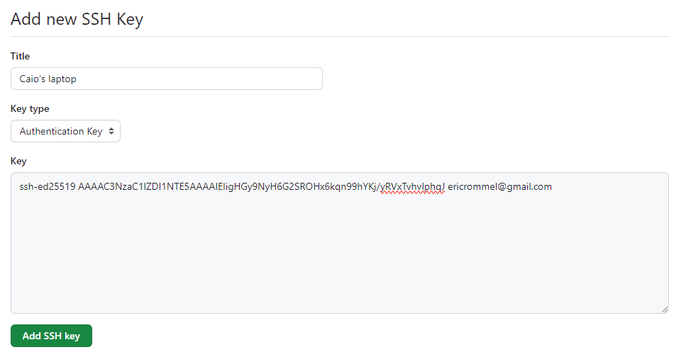
Fix Git/GitHub Integration
Now, go to your GitHub account and save your SSH KEY copied before
Add any title you want for your SSH KEY
Ctrl+V (paste) your SSH KEY saved from Git Bash
After clicking on that button, your SSH KEY is saved. You can go back and push your changes

Slide 20
Homework
Note: Add a screenshot for each completed task below on your Google Classroom
Install Git
Create a GitHub account
Clone the repository from https://github.com/ericrommel/ekids (git clone)
Make any change in (e.g.: any code homework available)
Add your changes (git add)
Commit your changes (git commit)
Push your changes (git push)

Slide 21
Docs and Books
Git Doc: https://git-scm.com/doc
GitHub Doc: https://docs.github.com/en
Book: Beginning Git and GitHub: A Comprehensive Guide to Version Control, Project Management, and Teamwork for the New Developer
Book: Version Control with Git and GitHub

Slide 22
Thank you!

